Slide 1
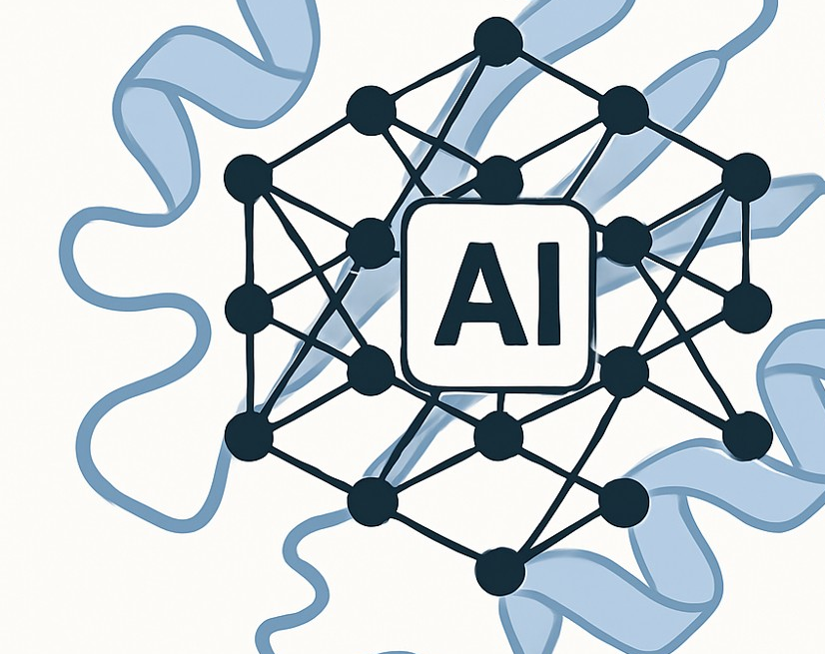
PiBook Bio:
The Data Engine for AI-First Protein Design

Slide 2
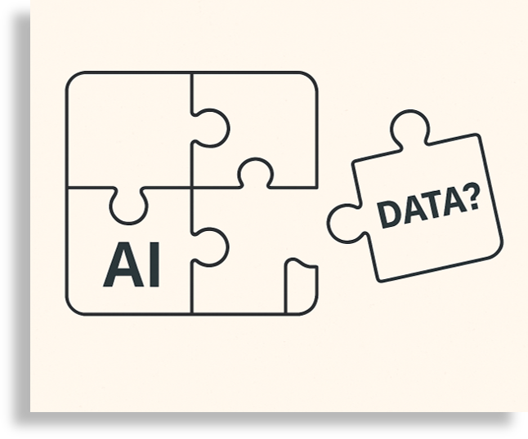
The Problem: AI in Protein Design is Stuck
AlphaFold started a revolution, but AI models still fail in practice
RFdiffusion’s success rate: just 0.1% for functional antibody design
Why? Lack of clean, functional, high-quality protein data

Slide 3
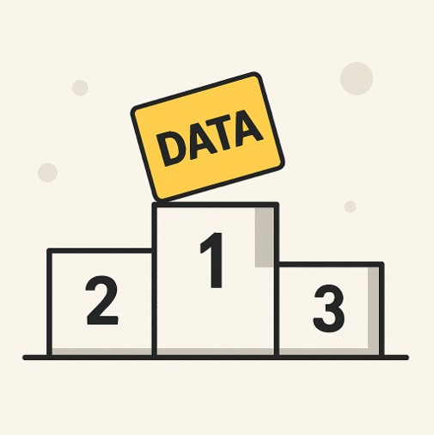
Our Insight: The Data Gap is the Opportunity
No clear leader in AI-protein design
Whoever owns the right data will lead this field

Slide 4
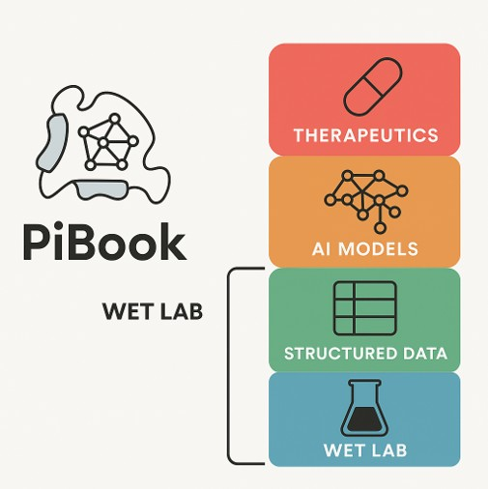
What We’re Building: A Full-Stack Protein Design Engine
High-throughput experimental platforms for AI-ready data generation
Domain-specific AI models trained on real-world proprietary data
A scalable engine for client projects and internal discovery

Slide 5
Our Data Engines: Validated Experimental Platforms
Phage Display
Successfully used to identify antibodies against tough membrane targets like the GABA and norepinephrine transporters.
Protein-Protein Interaction
Antibiotic-based PCA
Successfully used to identify thousands of novel peptides that bind to 14 BIR domains across 11 species.
Fluorescence-based PCA
Successfully established with leucine zipper and used to identify interacting pairs from pool of proteins involved in DNA metabolism in E. coli.
Protease-Substrate
Antibiotic-based
Successfully used to engineer a completely new protease-substrate pair from scratch.
Each of our high-throughput platforms are capable of minting million-billion data points
Fluorescence-based
Successfully used to crystallize armadillo-peptide protein complex.
Structure Accelerators
Color-based
Successfully established using β-galactosidase scaffold.

Slide 6
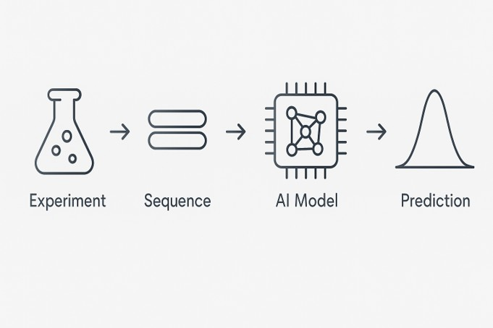
AI in Action: From Raw Data to Predictions
In-house classifier trained on BIR domain-peptide data
90%+ accuracy on binder vs. non-binder classification

Slide 7
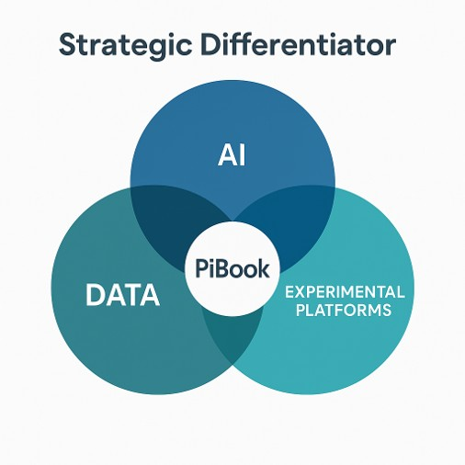
Strategic Differentiators: Why PiBook Wins
Multi-platform design = diverse, richer, and reliable data
Own data + task-specific AIs = superior performance, accurate predictions
Expandable infrastructures/experimental platforms

Slide 8
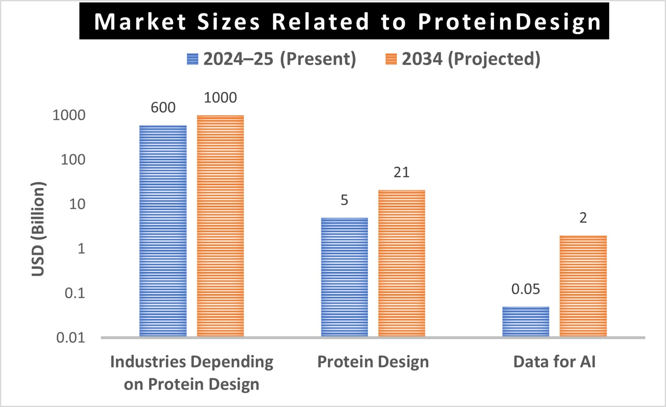
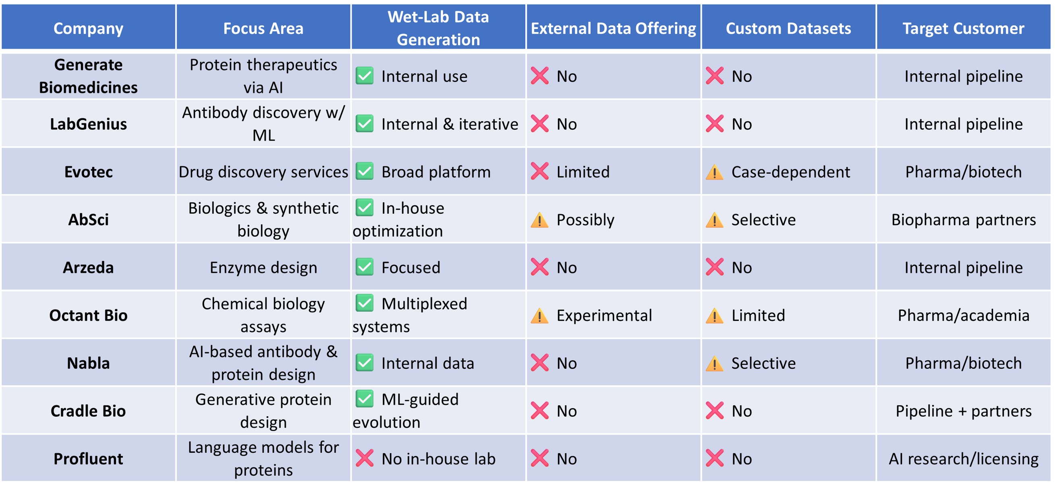
Market Opportunity: A Small Market with a Big Gap
PiBook Entry
Demand-Supply Gap

Slide 9
Go-to-Market Strategy: 1st Two Years
Target clients: AI-first biotech startups, biologics R&D labs, and pharma innovation teams
Priority projects: data-generation
Other projects: protein engineering campaigns and validation experiments
Scale up: through repeat clients and expansion into CROs and biotech

Slide 10
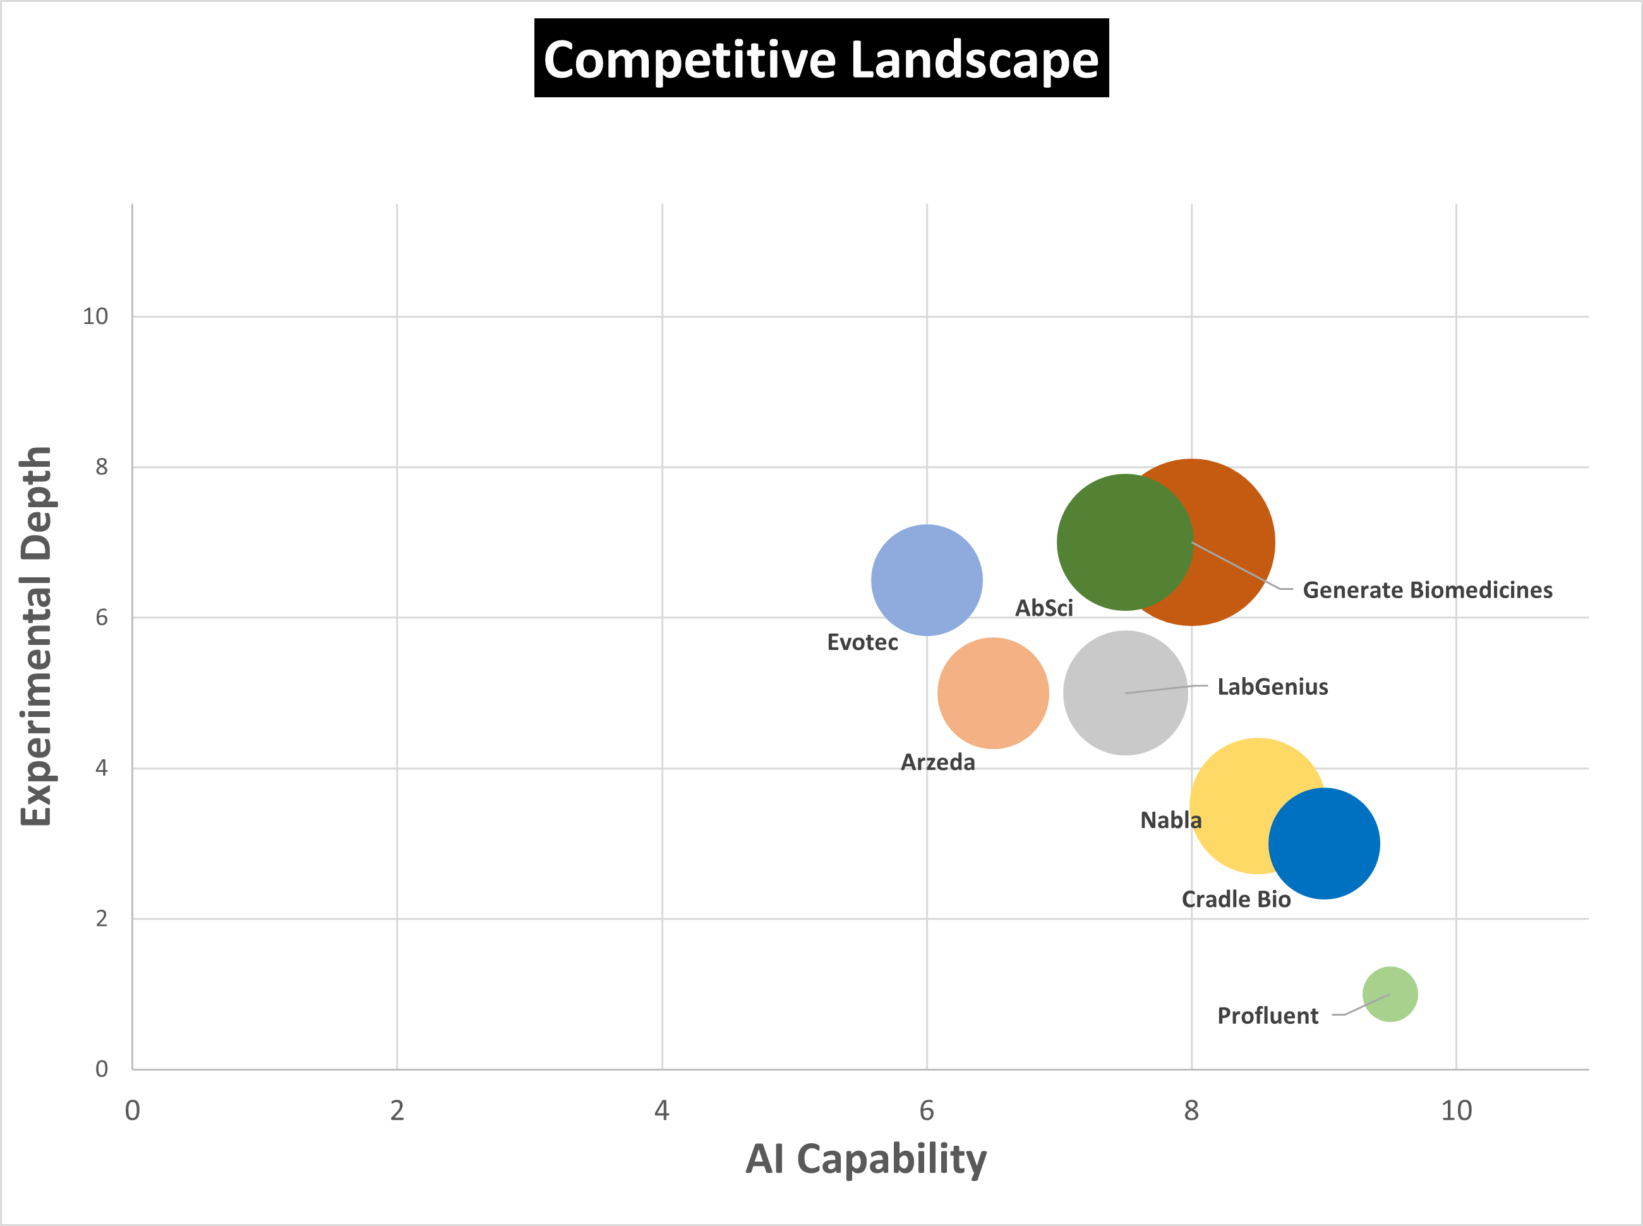
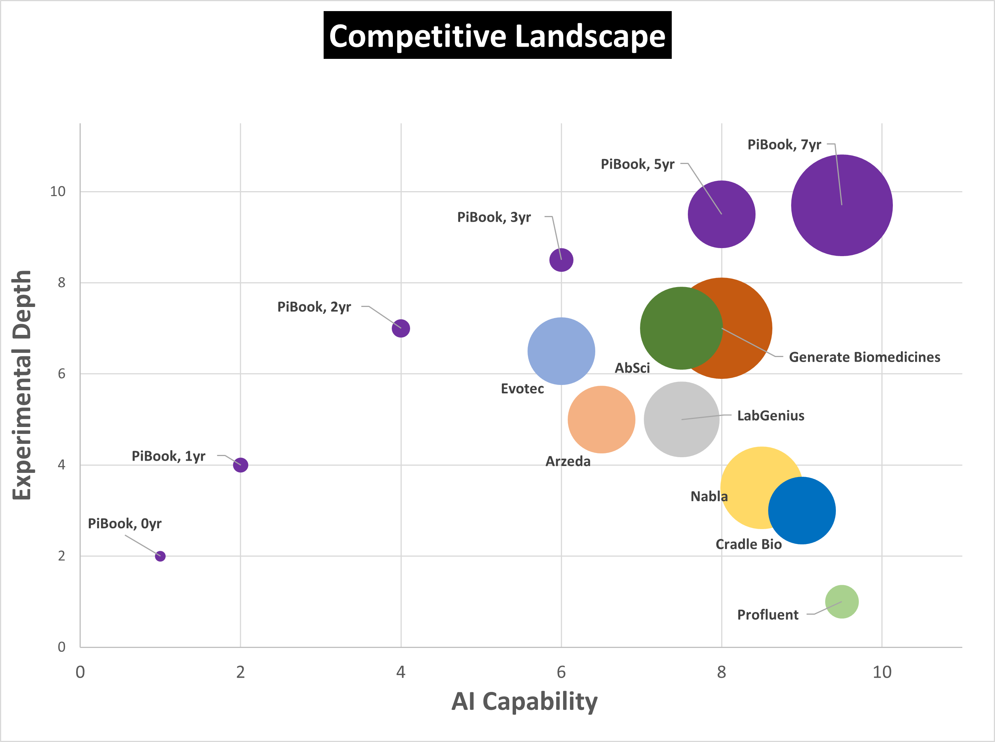
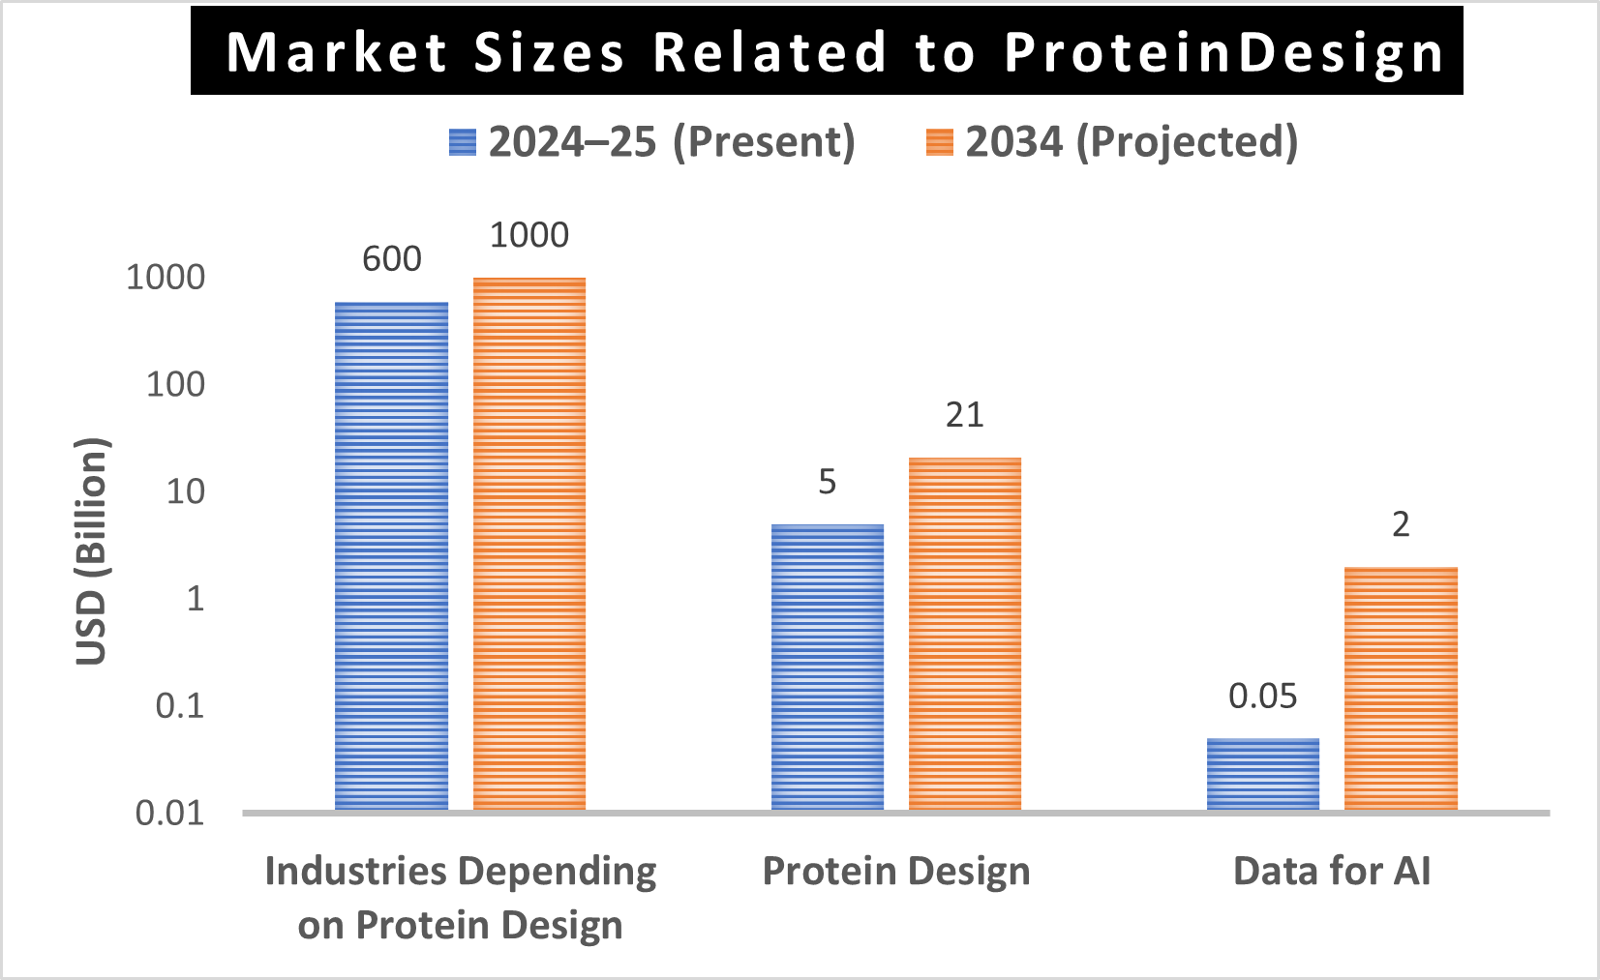
Growth Roadmap: Data Provider to Full-Stack Biotech
Full Stack
Drug IP
AI tools
Full Stack
Drug IP
Data
AI tools
Data

Slide 11
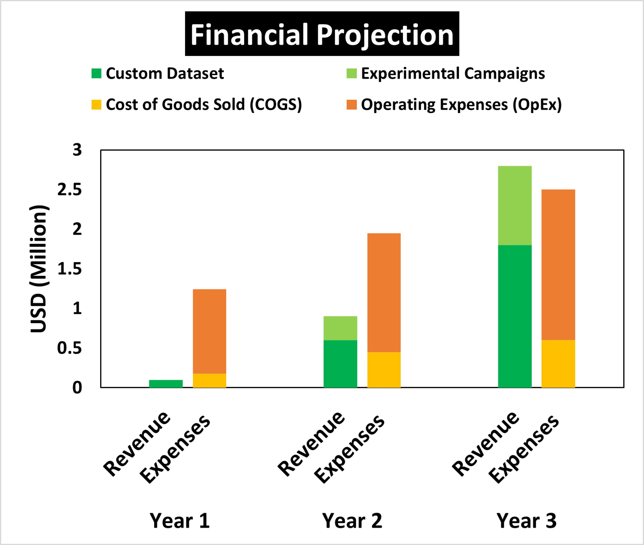
Business Model: Milestones and Revenue
Year 1: Almost zero revenue. Mostly building the setup
Year 2: Approx. $1Million revenue from client data projects
Year 3: Approx $3Million revenue, AI tools launched

Slide 12
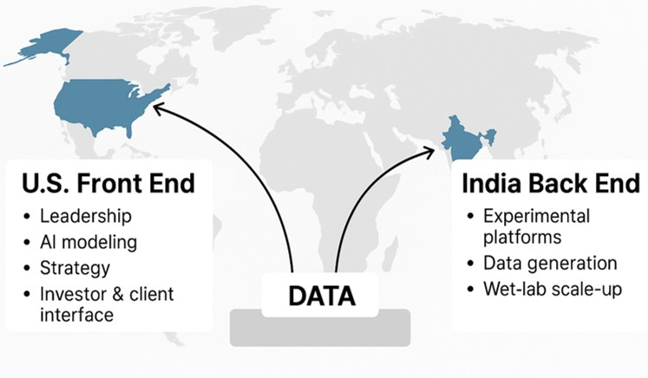
Global Execution Strategy: U.S.-India Hybrid
Fast, Scalable, Capital-efficient
U.S. front end: Client interface
2–3× more data throughput per dollar
India back end: Data generation

Slide 13
Founding Team: Full-Stack Founders
Dr. Tabrez Mohammad
AI/ML specialist, with 20+ years of active research experience, driving data strategy and computational integration across PiBook Bio.
Dr. Zahid Kamal
Expert in high-throughput technology platforms & protein structure research, with 20+ years of experience. Leads PiBook Bio’s experimental operations and assay development.

Slide 14
Scientific Collaborations: Top-tier Academic Partners
Prof. Tanweer Hussain
Developmental Biology and Genetics, Indian Institute of Science, Bangalore, India
https://dbg.iisc.ac.in/people/tanweer-hussain/
Prof. Aravind Penmatsa
Molecular Biophysics Unit, Indian Institute of Science, Bangalore, India
https://aplabmbu.weebly.com/

Slide 15
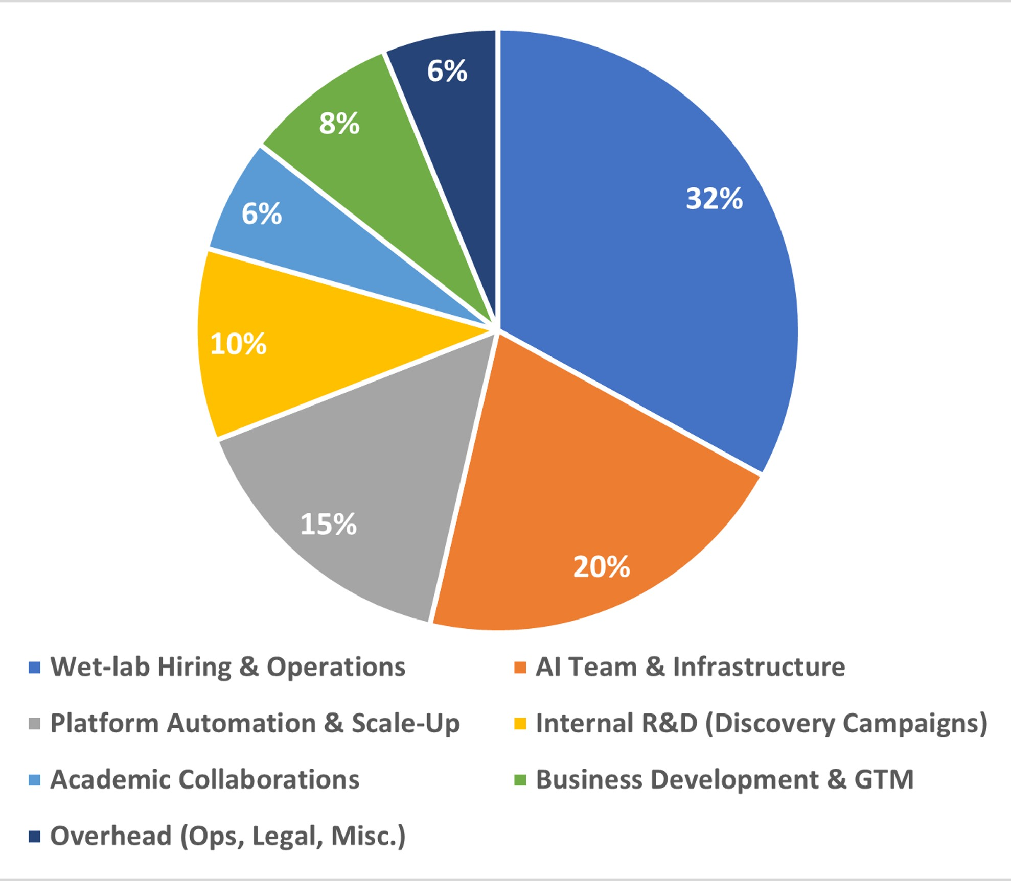
Use of Funds: $4M Seed round
Expand wet-lab and AI teams
Automate and scale platforms
Train predictive models and deliver client campaigns

Slide 16
PiBook: Built to Lead
AI has transformed the biotech industry, but stalled by Data gaps.
Our 3-phase growth path “data engine → AI layer → full-stack partner” fill these gaps at multiple level.
Recursion proved that the 3-Phase growth model is a winning strategy. They did that in cell biology — PiBook is doing it for protein design.
This is a Category-Defining Moment.
The opportunity is vast. The timing is perfect. The infrastructure is ready.
Let’s Roll…..

Slide 17
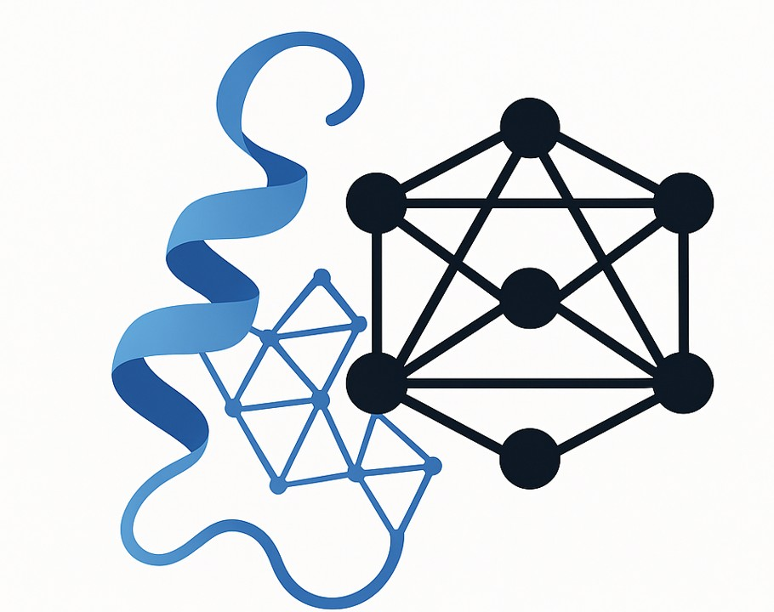
Thank You
PiBook Bio: www.pibookbio.com
Contact us: ceo@pibookbio.com
Zahid Kamal: mdzahidkamal@gmail.com
Tabrez Mohammad: mdtabrez@gmail.com

